Slide 1
Stock Prediction
Collin Tischner

Slide 2

Motivation
Stock market is very popular
Both people and banks can trade
Being profitable is difficult

Slide 3
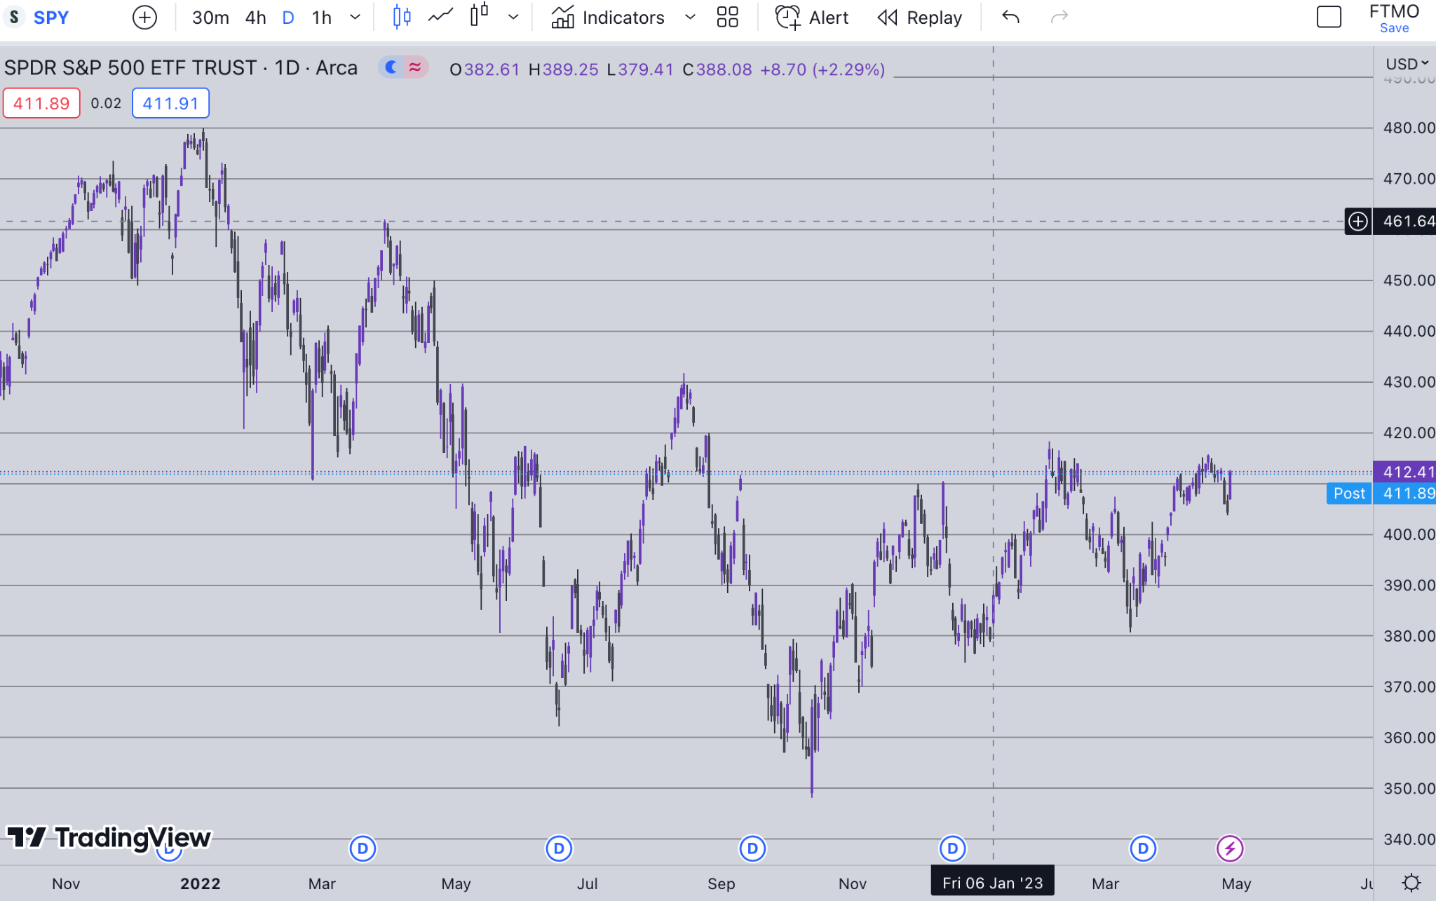
Objectives
Build a model to predict stock price, direction
Learn which models can help
Aid traders in becoming profitable

Slide 4
Related Work
ANNs are best for price prediction
SVMs for direction
GAs for portfolio selection
Suggestion for hybrid models
SVM model performed better in 5 out of 6 periods than two benchmarks
Buy and hold
Buying with positive close and vice versa
Can improve by reflecting real fees and commissions
Can use short positions in the SVM model

Slide 5
Related Work
LS-SVM-PSO hybrid model achieved lowest error value
LS-SVM had second lowest error value
ANN-BP had highest error value
ANN models are prone to overfitting

Slide 6
Related Work
ARIMA model works for linear data
Requires larger training set
BPNN has strong adaptability
FCM works with a relatively small training set
Difficulties arise as there are more dimensions in the data set
GRNN models have a faster training process than ANNs
Require more memory space
Gaussian Processes are flexible and the computation is relatively simple to implement
For running the analysis, it can be computationally expensive

Slide 7
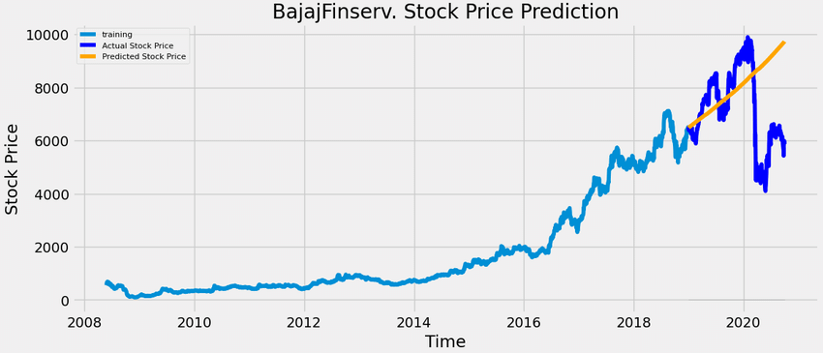
Problem
How can machine learning be used to predict the market?
Can machine learning be used to trade profitably?

Slide 8
Solution
Linear Regression Model
Logistic Regression Model
Random Forest Model
Long Short Term Memory model

Slide 9
Results
Near 0 r squared for linear regression
Near 0 r squared for linear regression
Accuracy for random forest of 54%
LSTM theoretical loss below 0

Slide 10


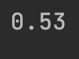
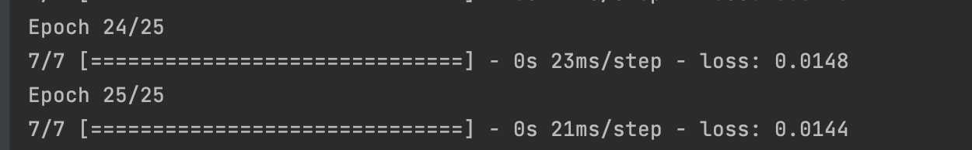
Results
Linear Regression
Logistic Regression
Random Forest
LSTM

Slide 11
References
Images:
https://www.nbcnews.com/business/markets/silence-wall-street-new-york-stock-exchange-prepares-all-electronic-n1166426
Second one is from Tradingview
https://www.researchgate.net/figure/Prediction-of-Stock-Price-using-ARIMA-model_fig5_349252835

Slide 12
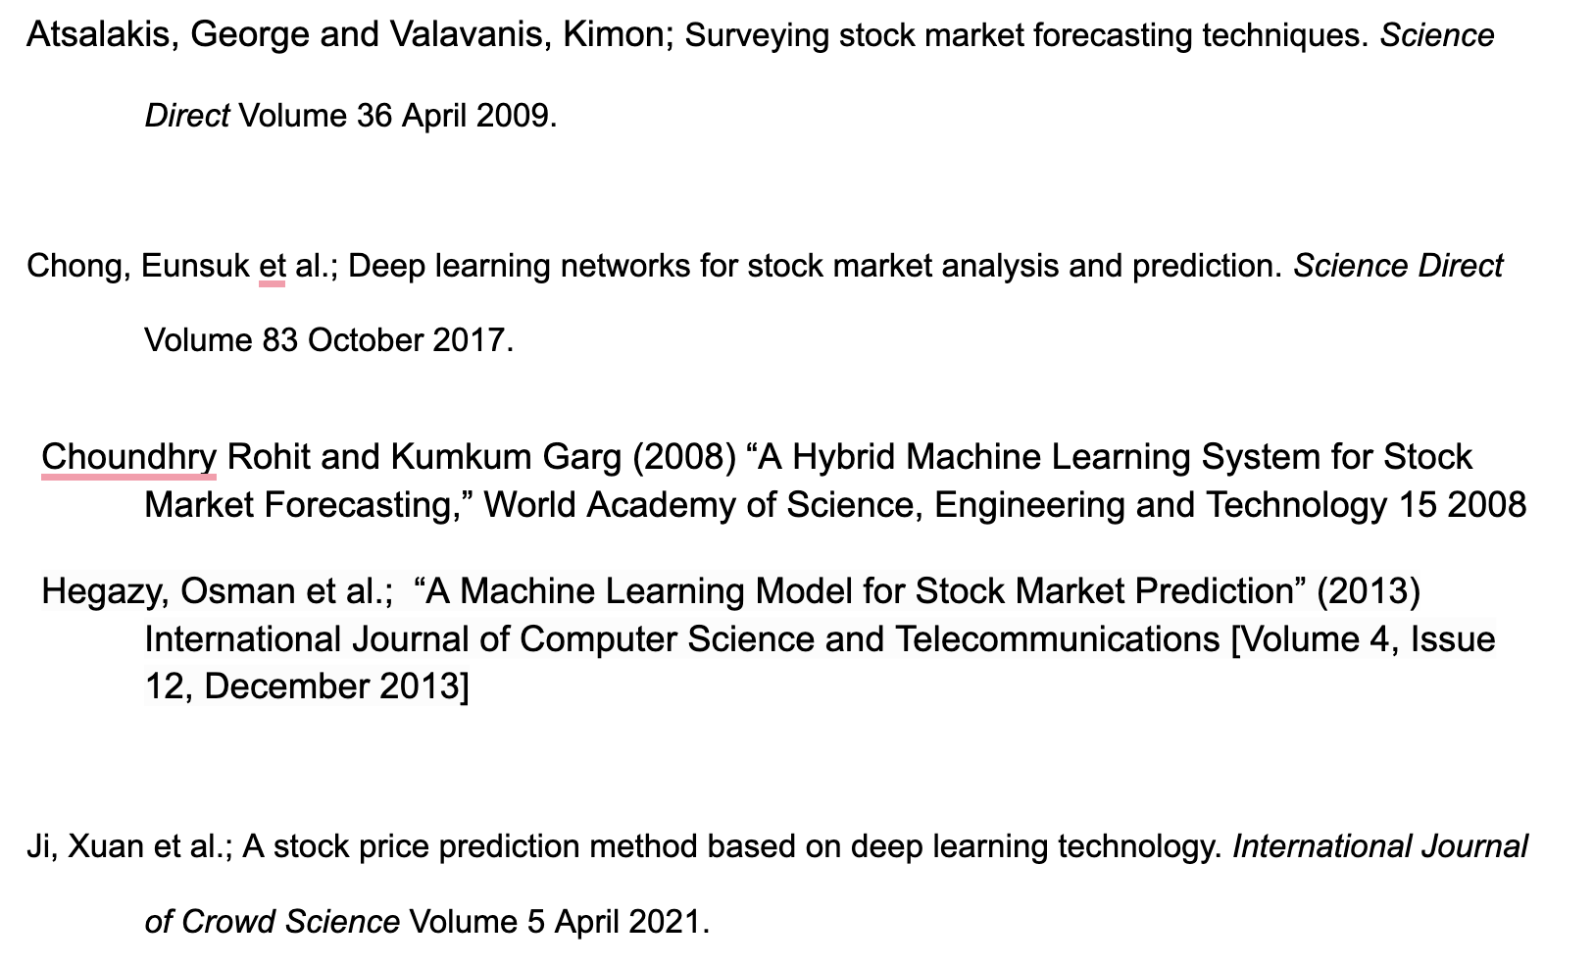
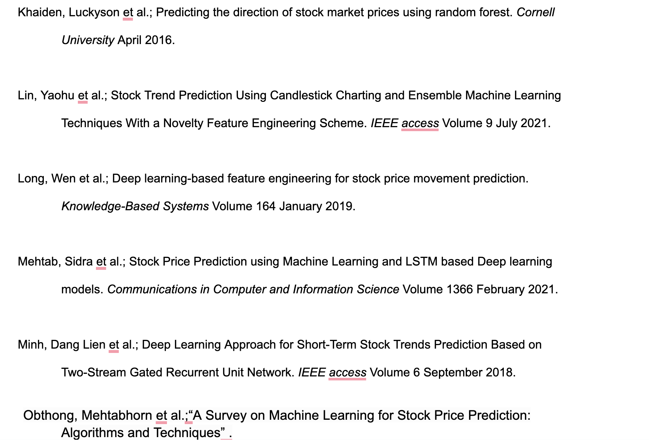
References

Slide 13
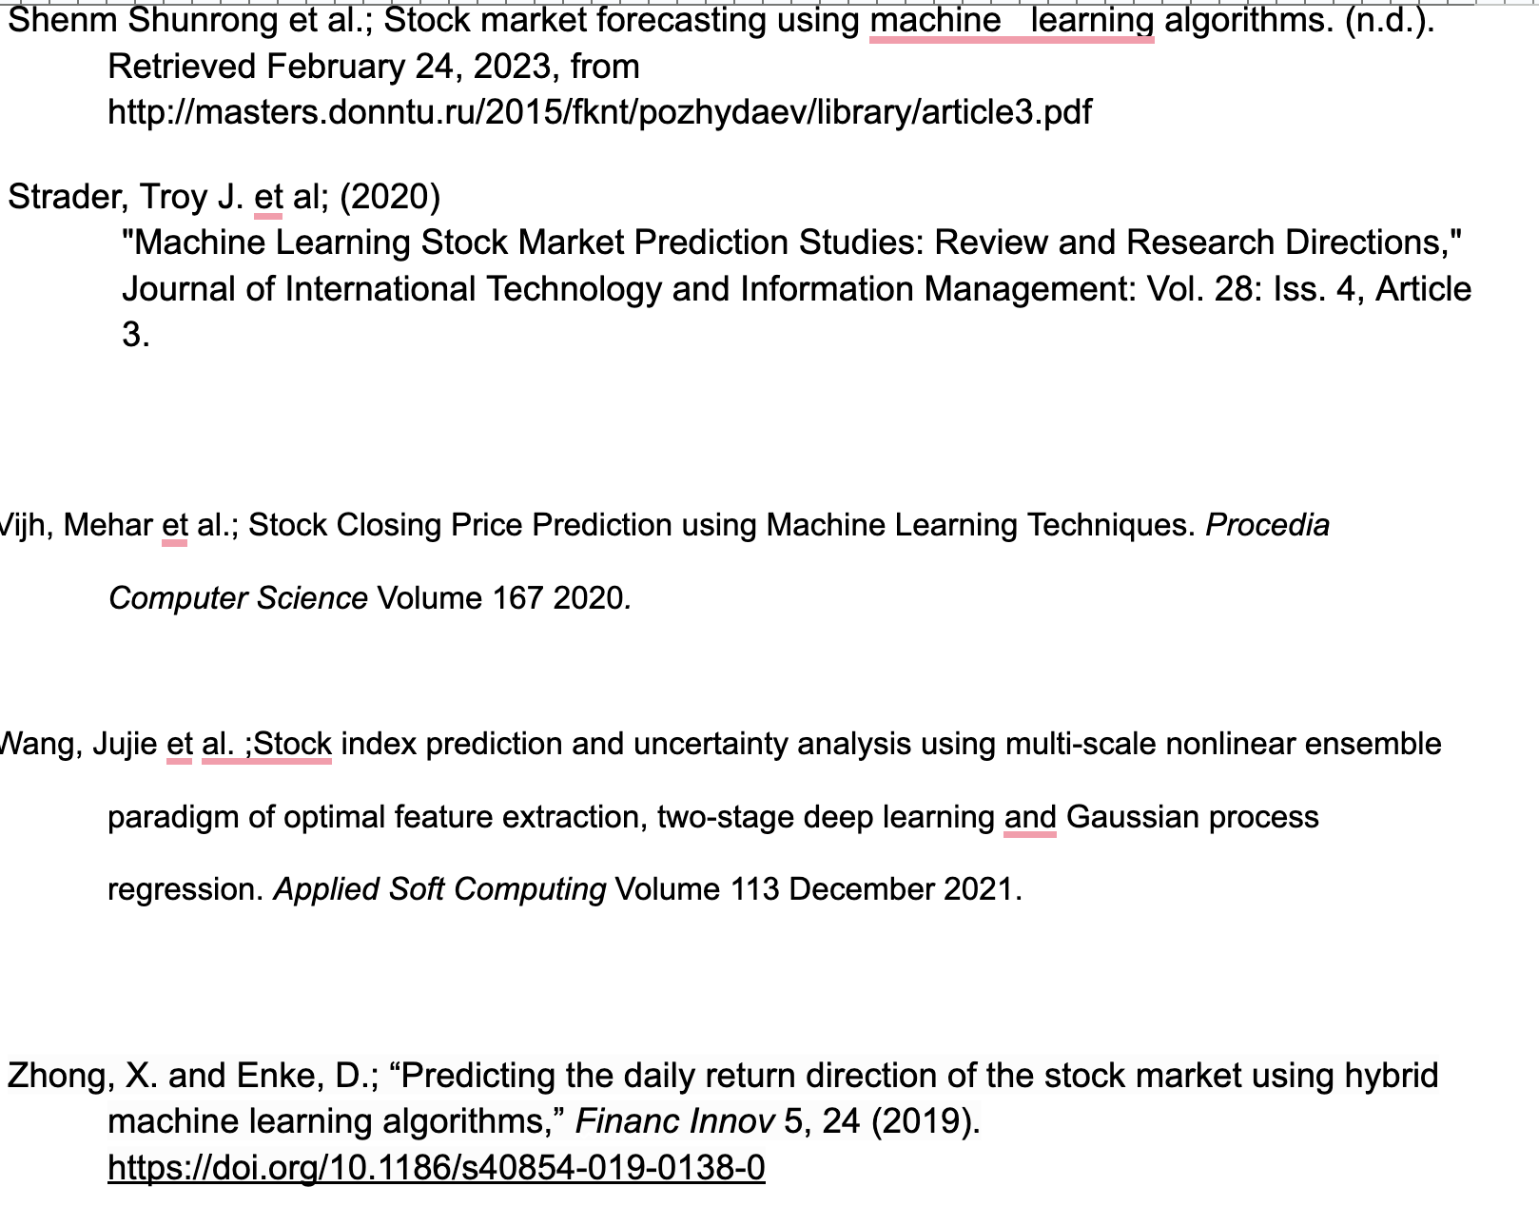
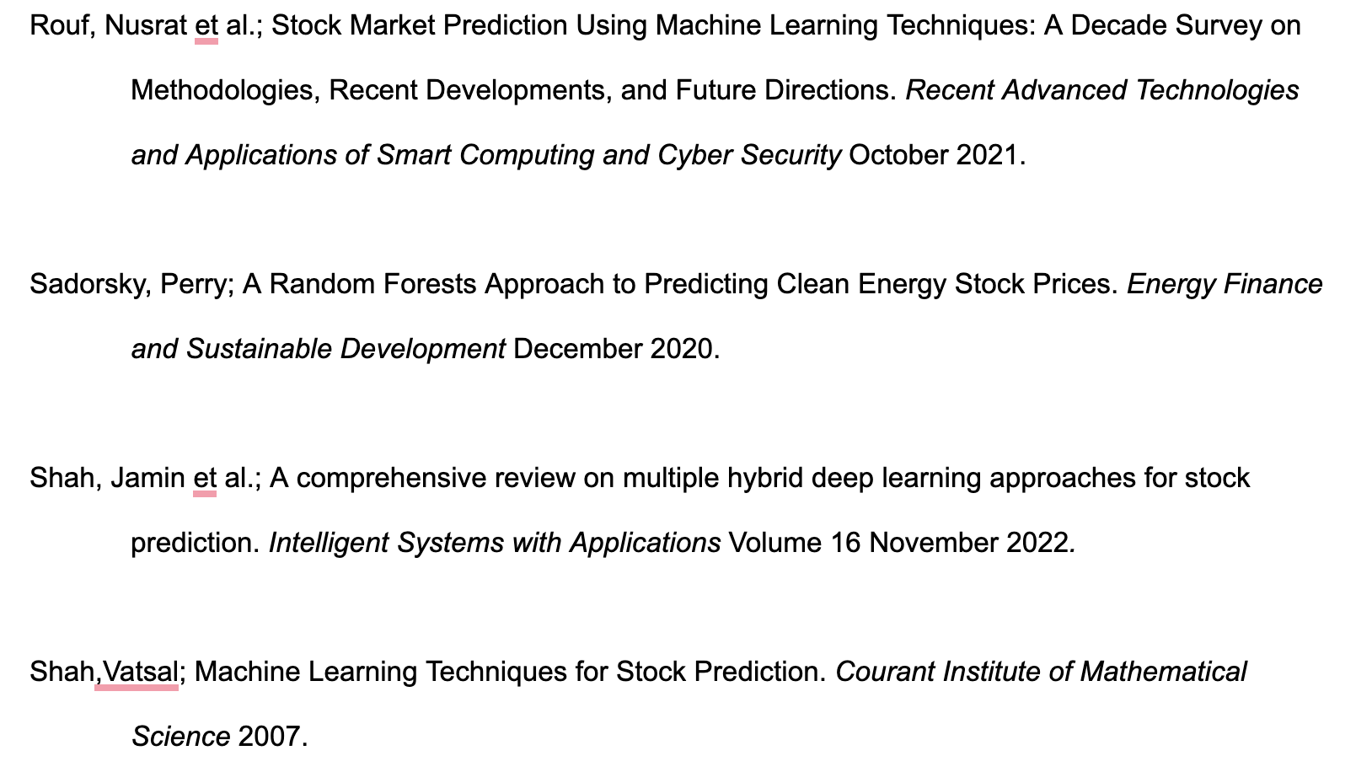
References

